Slide 1
PHP Loops

Slide 2
PHP Loops
Loops are used to execute the same block of code again and again, as long as a certain condition is true.
In PHP, we have the following loop types:
while - loops through a block of code as long as the specified condition is true.
do...while - loops through a block of code once, and then repeats the loop as long as the specified condition is true
for - loops through a block of code a specified number of times
foreach - loops through a block of code for each element in an array

Slide 3
PHP for Loop
for loop - Loops through a block of code a specified number of times.
The for loop is used when you know in advance how many times the script should run
Syntax
for (init counter; test counter; increment counter) { code to be executed for each iteration; }
Parameters:
init counter: Initialize the loop counter value
test counter: Evaluated for each loop iteration. If it evaluates to TRUE, the loop continues. If it evaluates to FALSE, the loop ends.
increment counter: Increases the loop counter value

Slide 4
WAP to print numbers from 0 to 10
<!DOCTYPE html>
<html>
<body>
<?php
for ($x = 0; $x <= 10; $x++) {
echo "The number is: $x <br>";
}
?>
</body>
</html>
Output:
The number is: 0 The number is: 1 The number is: 2 The number is: 3 The number is: 4 The number is: 5 The number is: 6 The number is: 7 The number is: 8 The number is: 9 The number is: 10

Slide 5
PHP while Loop
The while loop executes a block of code as long
as the specified condition is true.
Syntax
while (condition is true) { code to be executed; }

Slide 6
WAP to displays the numbers from 1 to 5
<!DOCTYPE html>
<html>
<body>
<?php
$x = 1;
while($x <= 5) {
echo "The number is: $x <br>";
$x++;
}
?>
</body>
</html>
Output:
The number is: 1 The number is: 2 The number is: 3 The number is: 4 The number is: 5

Slide 7
PHP do while Loop
The do...while loop - Loops through a block of code once, and then repeats the loop as long as the specified condition is true.
The do...while loop will always execute the block of code once, it will then check the condition, and repeat the loop while the specified condition is true.
Syntax
do { code to be executed; } while (condition is true);

Slide 8
WAP to displays the numbers from 1 to 5
<!DOCTYPE html>
<html>
<body>
<?php
$x = 1;
do {
echo "The number is: $x <br>";
$x++;
} while ($x <= 5);
?>
</body>
</html>
Output:
The number is: 1 The number is: 2 The number is: 3 The number is: 4 The number is: 5

Slide 9
PHP foreach Loop
This Loops through a block of code for each element in an array.
The foreach loop works only on arrays and is used to loop through each key/value pair in an array.
Syntax
foreach ($array as $value) { code to be executed; }
For every loop iteration, the value of the current array element
is assigned to $value and the array pointer is moved by one,
until it reaches the last array element.

Slide 10
The following example will output the values of the given array ($colors):
<!DOCTYPE html>
<html>
<body>
<?php
$colors = array("red", "green", "blue", "yellow");
foreach ($colors as $value) {
echo "$value <br>";
}
?>
</body>
</html>
Output:
red green blue yellow

Slide 11
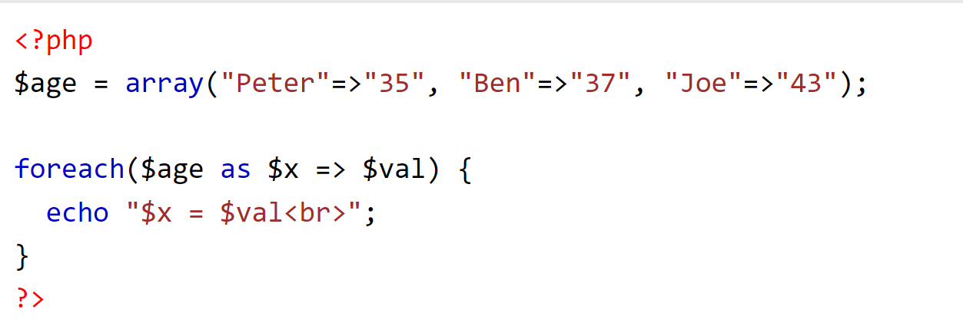
The following example will output both the keys and the values of the given array ($age):

Slide 12
PHP Break
The break statement can be used to "jump out" of a switch statement.
The break statement can also be used to jump out of a loop.
<!DOCTYPE html>
<html>
<body>
<?php
for ($x = 0; $x < 10; $x++) {
if ($x == 4) {
break;
}
echo "The number is: $x <br>";
}
?>
</body>
</html>
This example jumps out of the loop when x is equal to 4:
Output:
The number is: 0 The number is: 1 The number is: 2 The number is: 3

Slide 13
PHP Continue
The continue statement breaks one iteration (in the loop),
if a specified condition occurs and continues with the next iteration in the loop.
This example skips the value of 4:
<!DOCTYPE html>
<html>
<body>
<?php
for ($x = 0; $x < 10; $x++) {
if ($x == 4) {
continue;
}
echo "The number is: $x <br>";
}
?>
</body>
</html>
Output:
The number is: 0 The number is: 1 The number is: 2 The number is: 3 The number is: 5 The number is: 6 The number is: 7 The number is: 8 The number is: 9

